Slide 1
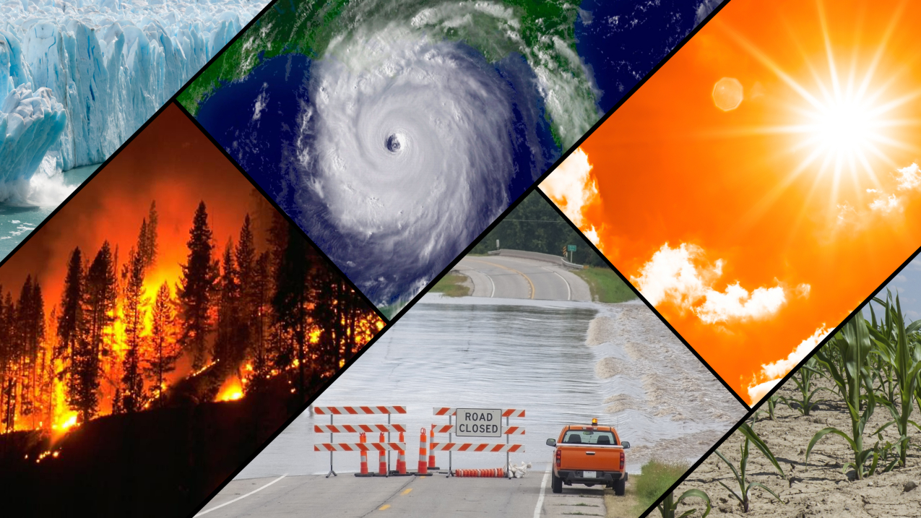
Adapting to Climate Change by Improving Extreme Weather Forecasts
Data Analysis & Interpretation
Amui Gayle
Christian Ekwomadu
David Osei-Poku
Joseph Becker
Deepak Bhadouria

Slide 2
OVERVIEW :
Climate change is causing an increase of extreme weather events across the planet. From heat waves and wildfires to hurricanes and flooding, these events have severe implications for agriculture, energy, transportation and low resource communities. To ensure people are prepared and can adjust accordingly, accurate long-term predictions of temperature and precipitation are vital.
At present, short-term weather forecasting is dominated by physics-based models, yet these have limited predictive horizons. The availability of abundance of meteorological data enables us data scientists to enhance sub-seasonal forecasts by combining physics-based forecasts with machine learning. In our project we attempted to improve longer-range weather forecasts to help people prepare and adapt to extreme weather events caused by climate change. Sub-seasonal forecasts for weather and climate conditions with lead-times ranging from 15 to more than 45 days will assist communities and industries to cope with the challenges arising from climate change.
Notes:
Climate change is causing an increase of extreme weather events across the planet. From heat waves and wildfires to hurricanes and flooding, these events have severe implications for agriculture, energy, transportation and low resource communities. To ensure people are prepared and can adjust accordingly, accurate long-term predictions of temperature and precipitation are vital.
At present, short-term weather forecasting is dominated by physics-based models, yet these have limited predictive horizons. The availability of abundance of meteorological data enables us data scientists to enhance sub-seasonal forecasts by combining physics-based forecasts with machine learning. In our project we attempted to improve longer-range weather forecasts to help people prepare and adapt to extreme weather events caused by climate change. Sub-seasonal forecasts for weather and climate conditions with lead-times ranging from 15 to more than 45 days will assist communities and industries to cope with the challenges arising from climate change.

Slide 3
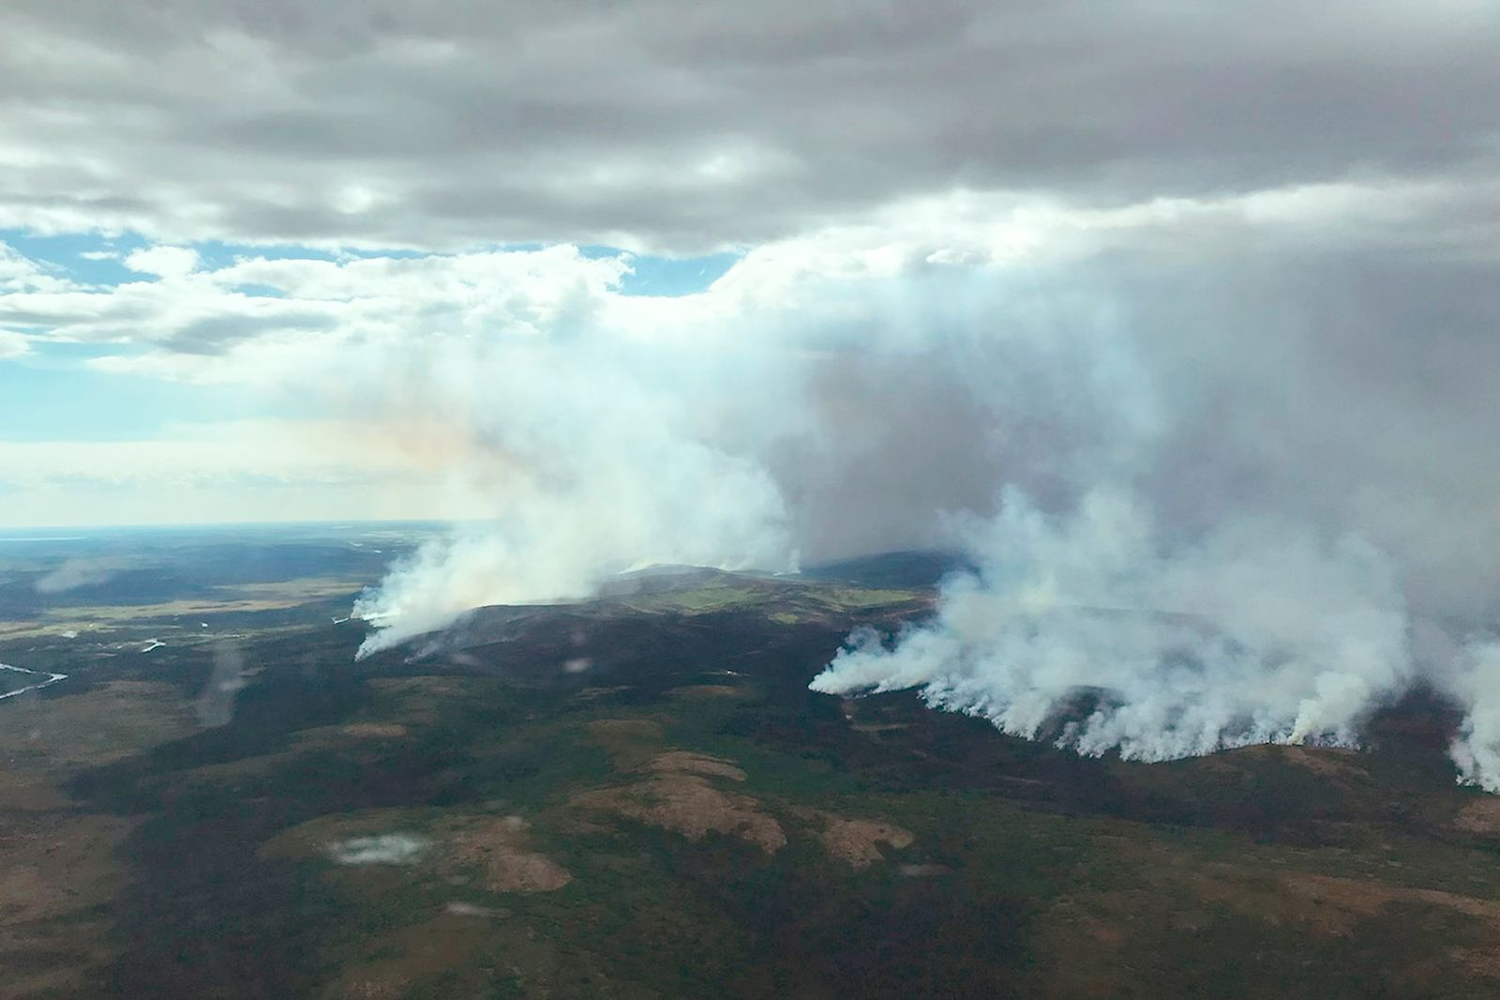
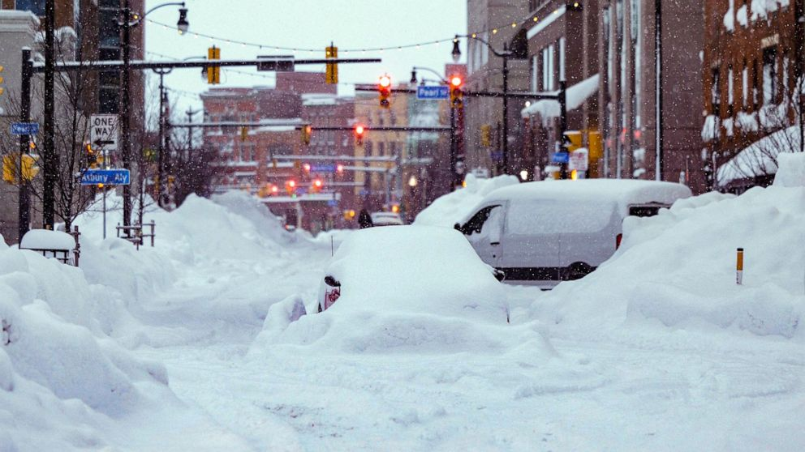
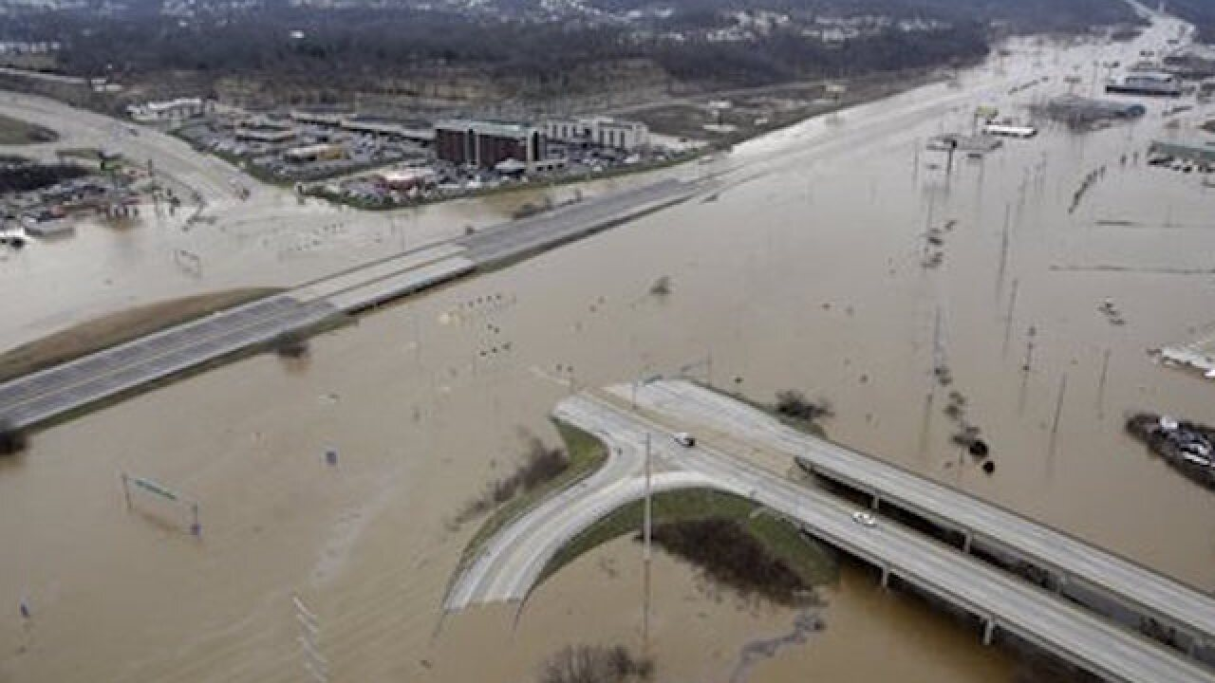
EXAMPLES
Notes:
Buffalo - Snowstorm, Storm Elliot, 37 people dead, 27 Dec 2022
Alaska - Wildfire
Missouri - Flood

Slide 4
Use, Intentions, & Stakeholders
Use + Intentions
Provide a longer outlook for when extreme weather events will occur
Warn residents of a potential incoming event with enough time to react in a timely manner
Stakeholders
Meteorologists
Federal Emergency Management Agency (FEMA)
Residents living in most highly impacted areas
Power Companies
Charitable organizations that shelter the homeless

Slide 5
Our dataset
Climate Change AI (CCAI).
Date Donated : 01/2023
Format: CSV
Columns: 245
Observations: 375,734
Source:
Kaggle (WIDS Datathon 2023)
Compiled from:
National Oceanic and Atmospheric Administration’s (NOAA) Climate Prediction Center
Australian Government Bureau of Meteorology
North American Multi-Model Ensemble (NMME)
Notes:
We are using a dataset obtained from Kaggle which contains weather and climate information for various locations in the US, beginning from a range of start dates for a two-week period, along with forecasted temperatures and precipitation from different weather forecast models. Each row in the data is associated with one location and start date and we intend to predict the arithmetic mean of the highest and lowest temperature over the next two weeks for each location and start date (the contest variable contest-tmp2m-14d__tmp2m).

Slide 6
Features
Temperature
Global precipitation
U.S. precipitation
Sea surface temperature and sea ice concentration
Relative humidity and sea level pressure
Geopotential height, zonal wind and longitudinal wind
Pressure and potential evaporation
Elevation
…and many more.
Notes:
We are using a dataset obtained from Kaggle which contains weather and climate information for various locations in the US, beginning from a range of start dates for a two-week period, along with forecasted temperatures and precipitation from different weather forecast models. Each row in the data is associated with one location and start date and we intend to predict the arithmetic mean of the highest and lowest temperature over the next two weeks for each location and start date (the contest variable contest-tmp2m-14d__tmp2m).

Slide 7
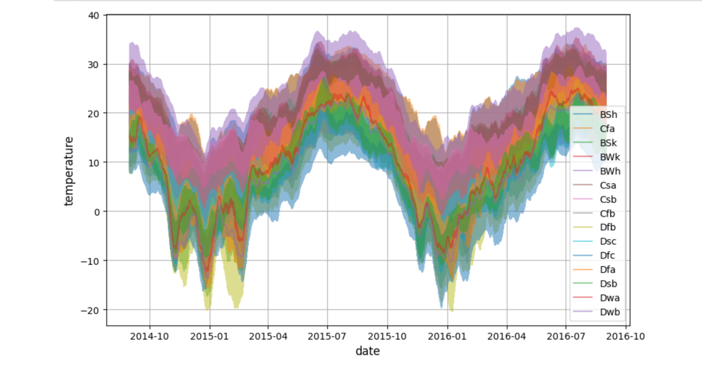
Visualization
Notes:
To get a better understanding of the dataset we were working with, we applied a couple of visualization measures to assist our objectives. We first generated this graph that shows the temperatures recorded over time for each of the regions in question as shown above with the key showing the separate regions.

Slide 8
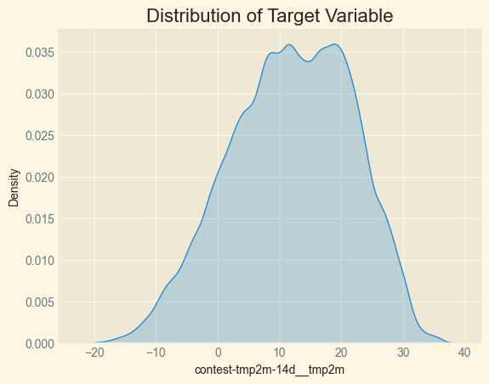
Visualization
Notes:
We also

Slide 9
Predict temperature
We decided to use an ANN to make our predictions
Created location groups using Lat and lon then One hot encoded location group feature (500 unique locations added 500 additional features to the dataset).
One hot encoded climate regions
Dropped lat, lon, and climate regions
Imputed Null values for 7 out of 8 columns with over 100,000 null values (using averages of related columns) and dropped the 8th.
Dropped index column
Separated Features from target
Normalized features using sklearn’s MinMaxScaler
Did an 80/20 train-test split on target and feature variables
Trained ANN to predict target
APPROACH
Notes:
The first step to any data-centric problem is preprocessing which prepare our data for further modelling and analysis. First, we removed any null values. Next, we merged certain columns(lat, lon) to produce a combined column. This helps in reducing the complexity of the dataset, making it easier to perform our analysis.
We then did some feature extraction using one hot encoder to convert categorical data into numerical data. We then split our data into test and train sets. This allows us to evaluate our models and fine-tune the parameters.
To find the accuracy of our model, we calculated Root Mean Squared Error (RSME). This is a standard method for evaluating the accuracy of machine learning models. Finally, we used several other models such as Lasso Regression and ReLU with linear activation to test loss for further analysis.
Created location groups using Lat and lon then One hot encoded location group feature (500 unique locations added 500 additional features to the dataset).
One hot encoded climate regions
Dropped lat, lon, and climate regions
Imputed Null values for 7 out of 8 columns with over 100,000 null values each and dropped the 8th.
Dropped index column
Separated Features from target
Normalized features using sklearn’s MinMaxScaler
Did an 80/20 train-test split on target and feature variables
Trained an ANN to predict target

Slide 10
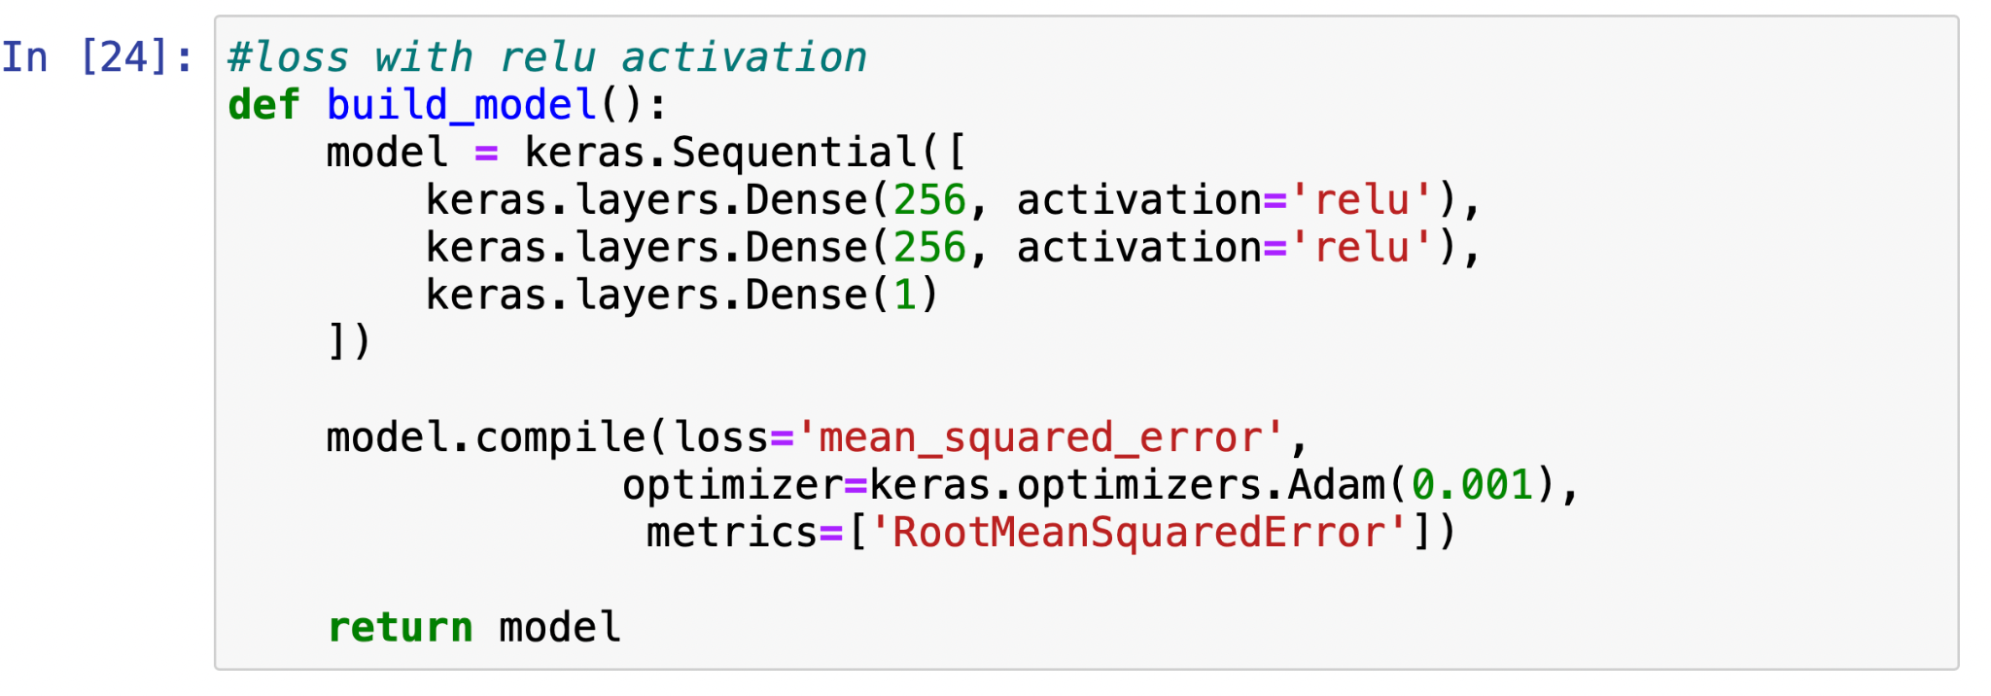
Model

Slide 11
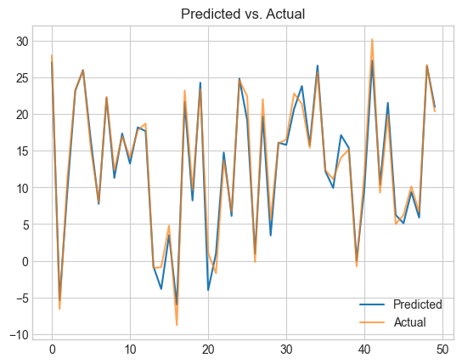
Results
Validation RMSE of 0.26 after training 20 epochs

Slide 12
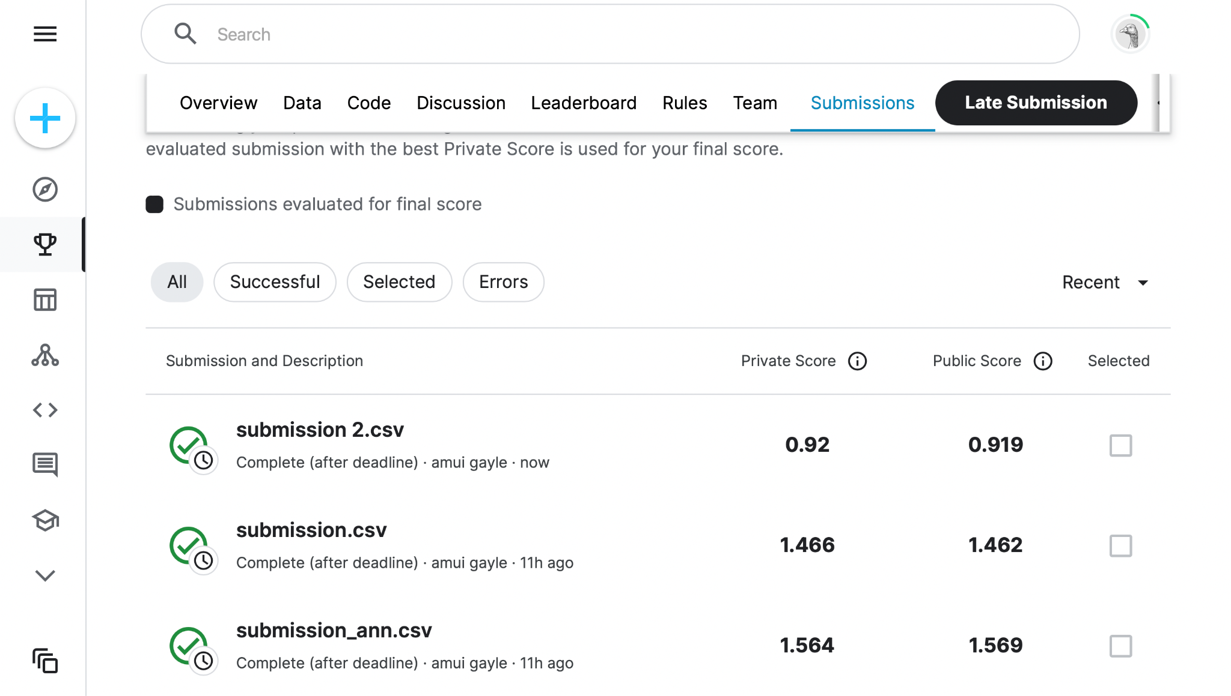
Results

Slide 13
Challenges +Future Improvements
Limitations:
Time taken to train the model
Potential Model Improvements:
Train for more epochs
Try predictions using an ensemble of models

Slide 14
Conclusions
Predicting the weather is challenging, especially as the prediction window gets further away from the latest data
So many different factors can influence what the temperature will be on any given day
Machine learning can determine which of these factors are strongly correlated with expected outcomes to inform predictive models
Advancements in computing technology and machine learning algorithms will continue to improve as time goes on, yielding ever improving models

Slide 15
Individual Skills and Contributions
Amui Gayle:
Skills: Python, SQL
Contributions: Dataset Identification, Model development
Christian Ekwomadu:
Skills: Python, R, and SQL
Contributions: Presentation
David Osei-Poku:
Skills: SQL, Python, Microsoft Office
Contributions: Data Visualization
Joe Becker:
Skills: Python, SQL, Excel
Contributions: Presentation
Dheepak Bhadouria:
Skills: Python, SQL
Contributions: Visualization

